Slide 1

The application of an interoperable methodology based on GIS principles to undertake a flood risk assessment for Gauteng.
Dr. Dawie Jansen van Vuuren
SMEC SA
1. Broad overview of interoperability perspectives
2. Case study – Gauteng hydrological study
3. Discussion

Slide 2
Perspectives on Interoperability (Just scratching the surface here)
Interoperability has been a goal of the computer industry for years. In the GIS arena interoperability has been a serious concern since the late 1970s.
The term ‘interoperability’ has a range of meanings, but all focus on the ability to move easily from one system to another (Sondheim et. al., 1997)
“Interoperability is at its best when it is implemented to support real world workflows.”
(Geospatial World, 2010)
Organisational Interoperability
The “ability of a collection of system components to share specified information and operate on that according to a shared operational semantics in order to achieve aspecific purpose in a given context” (Mans-Callejo & Wachowicz, 2009 in Jones, 2013)
Interoperability is “when technologies shake hands”
(Geospatial World, 2010)
Technological Interoperability
Notes:
Interoperability is not a new concept and has been the focus in the GIS industry for many years. I would like to share a few thoughts as an introduction before looking at a case study where integration between two software platforms it was a key requirement in the outcome of a project.

Slide 3
Perspectives on Interoperability
Sondheim et. al. (1997) describe interoperability in terms of
Direct data translation e.g. ETL tools – (extract, transform, load) such as FME, a data integration software platform transforming data between different data models (e.g. hierarchical XML to relational Geodatabase)
Common data format (e.g. shapefile for exchange between GIS & CAD)
Common interface across a network based distributed computing platform
Notes:
Looking deeper from a functional perspective Sondheim describe interoperability in the context of data sharing and system application.

Slide 4
Perspectives on Interoperability
Interoperability is essentially one view of the push for open systems (Sondheim et. al., 1997).
Kottman (1999) describes it as pointing at a possible development path for OpenGIS focussing on a special aspect of interoperability: the preservation of meaning
“GIS is not so much a scientific discipline in its own right, as it is a language for the representation of geospatial information. Hence GIS projects always reflect the specific discipline or disciplines of their owners”.
Different paradigms in action
Notes:
Interoperability is of particular concern in the open source arena. It is essentially one view of …
Looking at our case study later on, I think this is perhaps one of the perspectives that come out strongly.
One can therefore conclude that interoperability has different meanings depending on the paradigm within which one operates.

Slide 5

Perspectives on Interoperability - Different paradigms in Action
Planners
The World of Things
Engineers
Things in the World
“The Engineer’s requirements continue to be best met by a model and drawing paradigm”
“The needs of the planner are best met by a continuous database, a GIS”
(Geospatial World, 2010)
Spatial Database
Environment
CAD / BIM Objects
Structures
Notes:
I would like to interpret the concept of different paradigms as follows.
Planners vs Engineers…
A road is for a planner and an engineer two different things. For the one it is a piece of construction and for the other it means accessibility between two cities. Which of the two would have a stronger focus on spatial analysis?

Slide 6
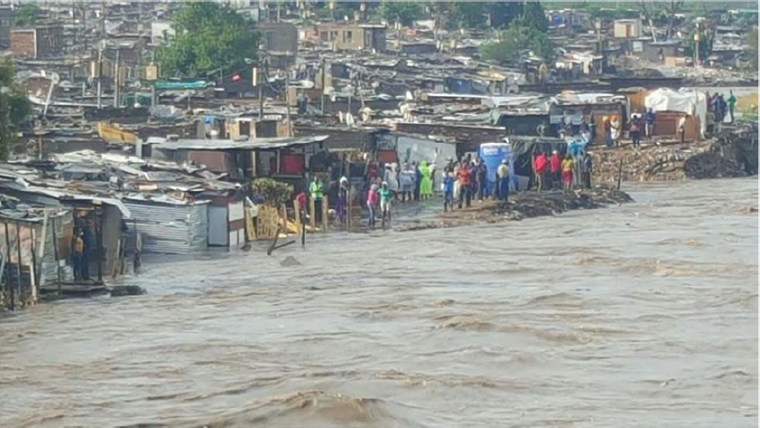
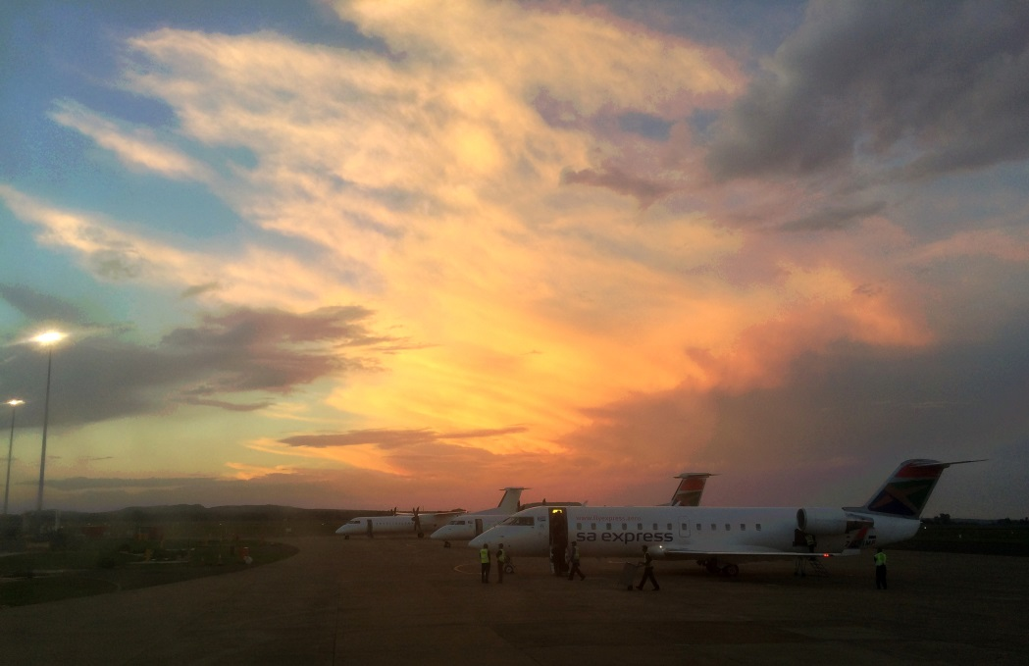
12 Nov 2016
Alexandra
Gauteng Hydrological Study
& Flood Risk Assessment 2018
Linksfield – N3 Highway
Bram Fischer Airport, Bloemfontein
Notes:
As is noted from publications on climate change, there is an increase in the intensity of storms. On 9th of November 2016 a deadly flash flood occurred, affecting informal settlements, townships, public infrastructure, as well the OR Tambo International Airport which is a National Key Point. Over 100 vehicles were damaged and some washed away on the N1 and the N3 freeway. The direct impacts are described in the ensuing impact assessment report. The indirect impacts are, however, not assessed. Just to mention one example, I was on that day and time returning to Jhb on a flight from Bloemfontein and all flights for that afternoon were delayed because of the situation at OR Tambo airfield. The knock-on economic impacts of such events might never be assessed.
As an outcome of the report a number of intervention measures were identified, one of which states that “The provincial government will undertake a comprehensive hydrological run-off modelling to ensure that the Municipal drainage systems are expanded to accommodate massive water flows in the roads.” (COGTA, 2016). A service provider has subsequently been appointed to undertake hydrological run-off modelling for the whole province (COGTA, 2018) and I have had the privilege to partake in this study.

Slide 7
Gauteng Hydrological Study
& Flood Risk Assessment 2018
ArcGIS
PCSWMM
Data Processing
Spatial Analysis
Mapping
Hydrological Modeling
Catchment
Runoff
Inundation
Notes:
The use of two software platforms is illustrated here: ArcGIS and PCSWMM.
I don’t have to say more about the ArcGIS platform, which I think is familiar to most of you here. We could have chosen QGIS as well, but for the raster data processing required, we chose the ArcGIS platform. Concepts of data processing, analysis and mapping are highlighted here
PCSWMM is advanced modeling software for stormwater, wastewater, watershed and water distribution systems. Concepts of catchment delineation, continuous modeling of surface rainfall and runoff are highlighted here.

Slide 8
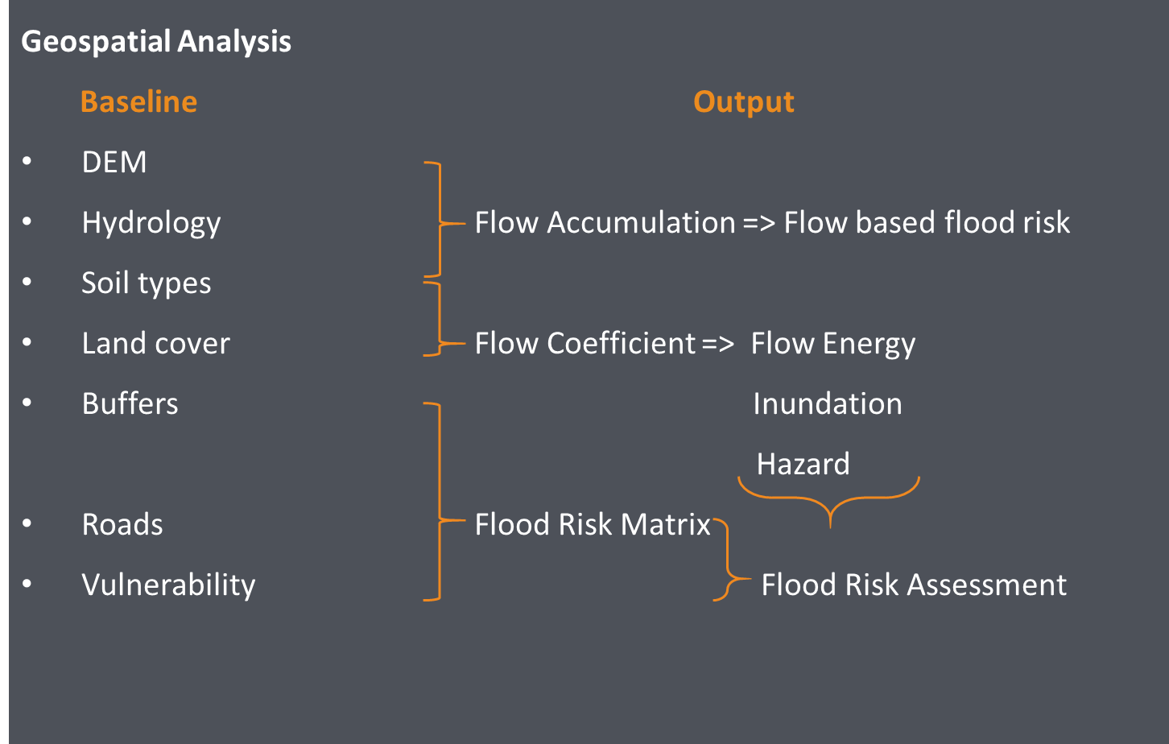
Notes:
Following the Information Systems concept of INPUT > PROCESSING > OUTPUT, I will give a brief overview of our approach.
The required baseline data input is determined by examining the output that needs to be delivered in terms of the project Scope of Work and the analyses that need to be undertaken to develop the required output.
I have to highlight that, in general, the importance of data processing is not fully understood by project managers. There is a persisting perception that GIS is about the making of maps with a focus on map making activities. Where timelines and budgets are considered there is no due recognition of the costs of data, e.g. acquiring existing data or capturing data using remote sensing technology. The time that is required to process data is not understood, which puts pressure on the process and on staff undertaking the analyses. In this project I was able to demonstrate the core values of GIS as an analysis tool on a multi-disciplinary level, showing the need for data management especially where spatial data need to be exchanged between software platforms.

Slide 9
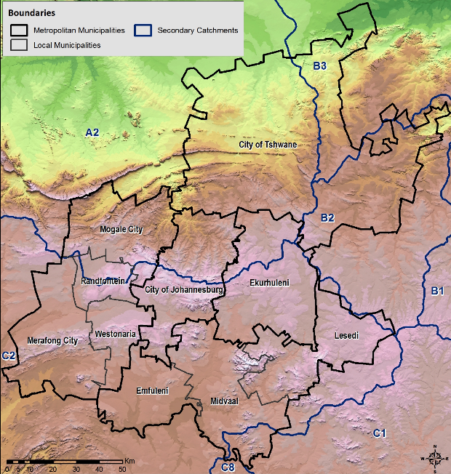
STUDY AREA & APPROACH
Study Area:
  Gauteng Province.
Notes:
The study area is the Gauteng Province in South Africa, comprising some 18,000 km2. The significance of this extent is the implications it has with regard determining the optimal resolution for data processing, taking into account the doubling of the surface area when drawing the frame for the DEM which is a rectangular shape, as shown here.

Slide 10
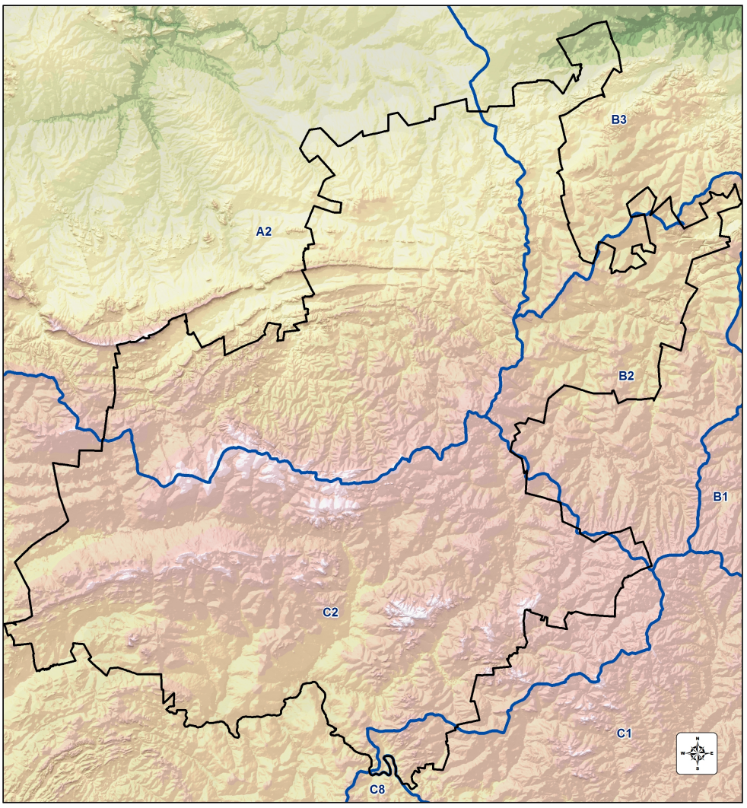

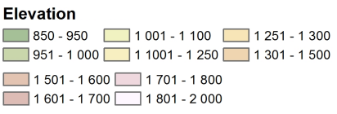
TOPOGRAPHICAL ANALYSIS
All flooding originate from within Gauteng
Continental divide
Notes:
The first and most important aspect of the study is the unique topographical feature of Gauteng. All runoff from rainfall originate from within the province – only a one small catchment in the south-east flow in from the outside of its boundaries

Slide 11
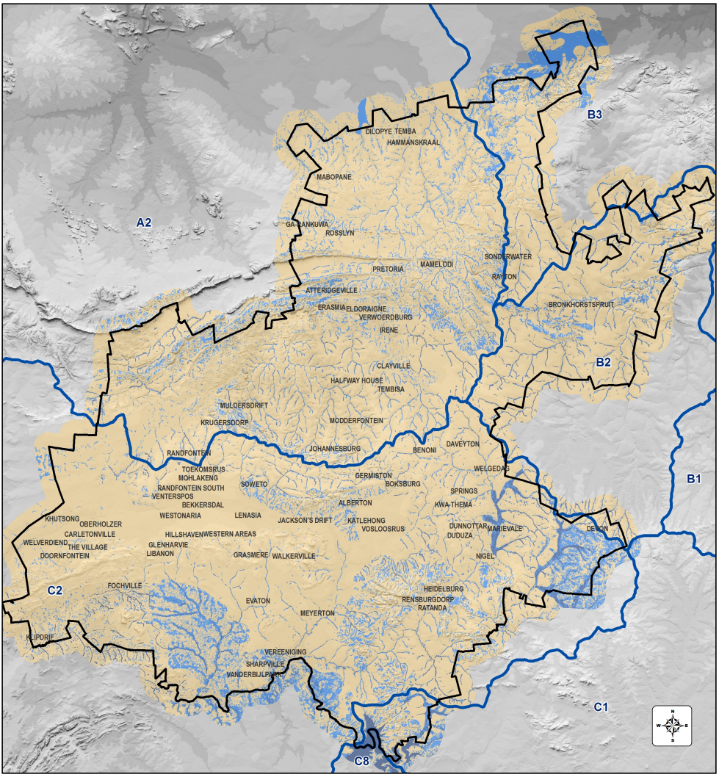
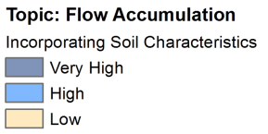
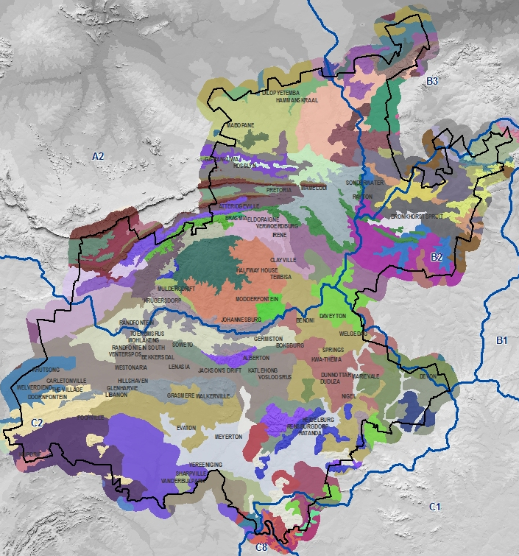
DATA PROCESSING & ANALYSIS
Soil based Flow Accumulation
+
Notes:
The surface flow of water is affected by the surface conditions and the underlying vegetation and soil types. Hard surfaces, and in particular road surfaces, were integrated with Land Type data to compile a permeability dataset. This was further integrated with the DEM data to undertake a surface based water flow accumulation analysis.

Slide 12
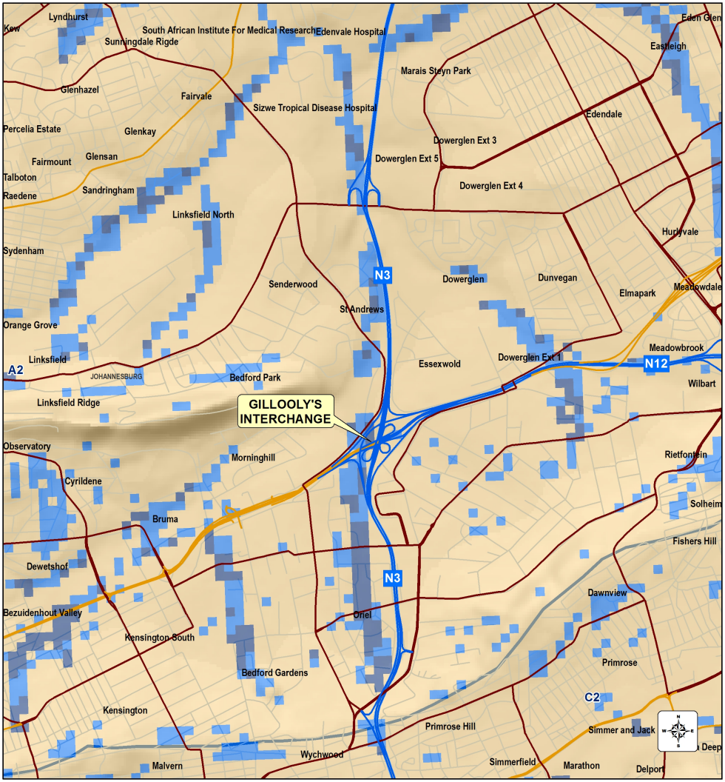
OUTPUT
Soil based Flow Accumulation
Notes:
Early results of the flow accumulation analysis were tested by looking at the Gillooley’s interchange area, which was earlier identified as a hotspot. The accumulation of water on and next to road surfaces is noticeable. The barrier effect of the Linksfield road crossing (bridge), which ultimately caused the flooding of the N3 to the south of the crossing is also noted.

Slide 13
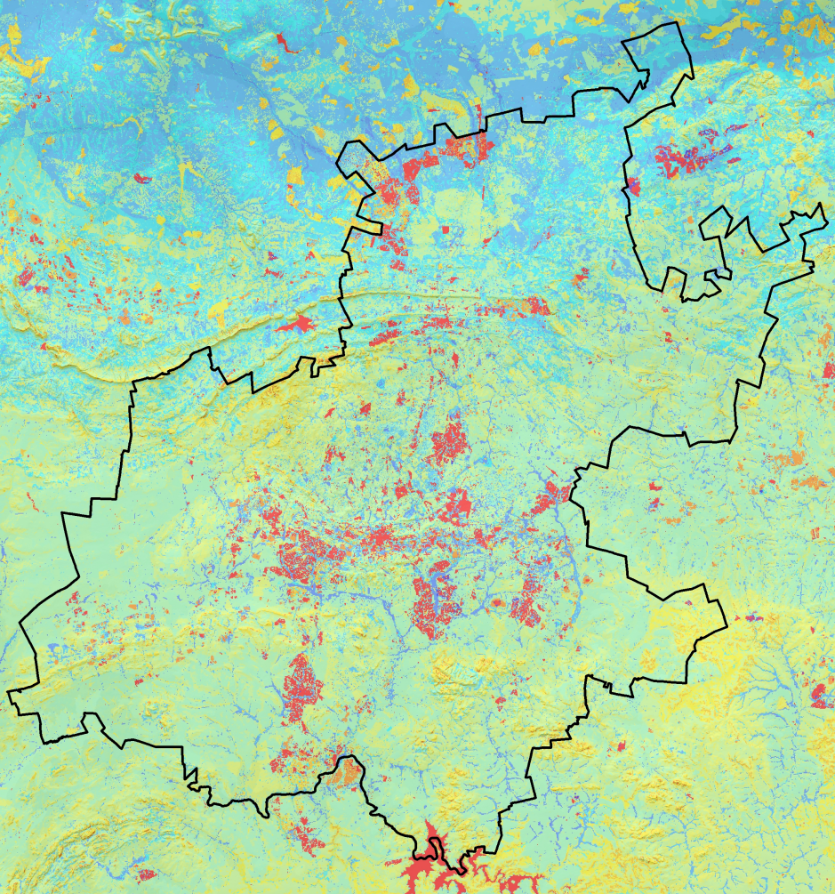
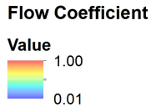
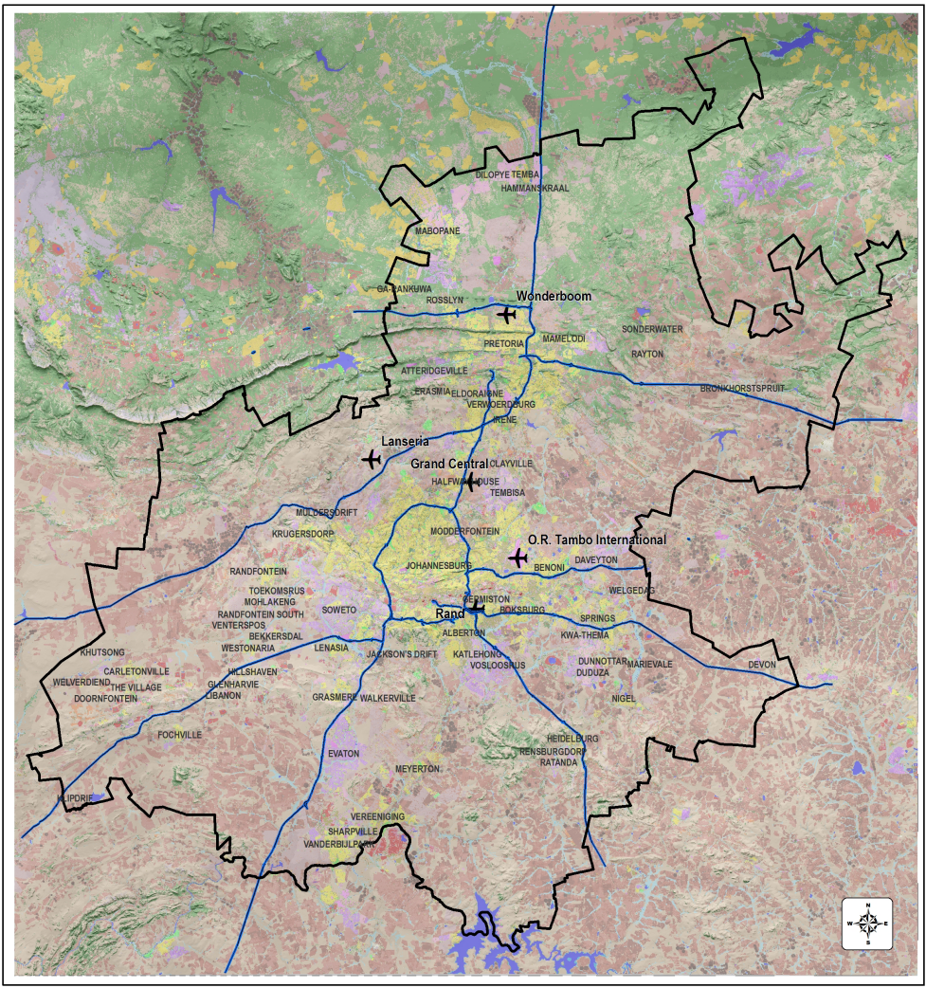
DATA PROCESSING & OUTPUT
Flow Coefficient
Soil Characteristics &
Land cover
&
Topography
+
Notes:
A flow coefficient analysis was undertaken based on the permeability qualities as well as other variables such as land use and slope that was further used as input for the hydrological modelling.

Slide 14
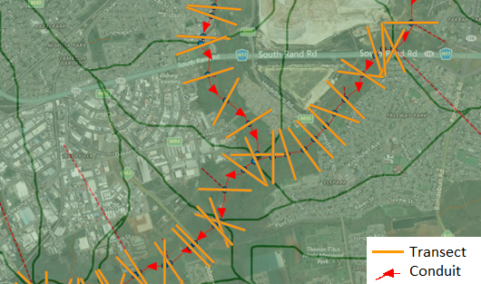
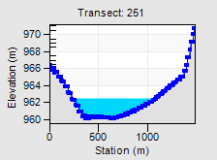
HYDROLOGICAL MODELLING
Hydrological modelling is done by discretising the catchment into a number of sub-catchments, each with unique sets of characteristics representing the topography
Notes:
A brief overview of hydrological modelling is given. Hydrological modelling is done by subdividing a catchment area into a number of sub-catchments, each of which have unique characteristics representing the topography such as:
Area and slope;
Hydrological losses such as initial abstraction;
Infiltration capacity of the soil
Runoff coefficient;
Hydrological response time of the sub-catchment such as overland flow length (that is derived from the aspect ratio of the sub-catchment shape);
The roughness of the pervious and impervious portions of the sub-catchment.

Slide 15
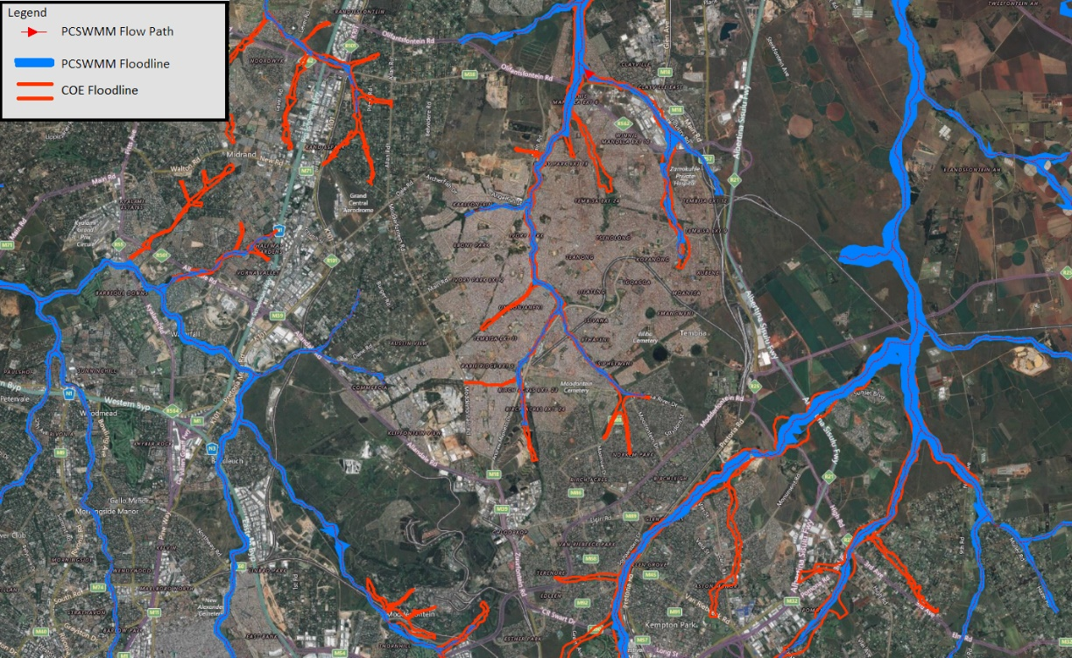
ANALYSIS
Conduit / Flood Inundation
Notes:
The output of the hydrological modelling is a conduit dataset which is indicative of flood line delineation. These results were compared with existing flood lines obtained from the Johannesburg and Tshwane Metropolitan Municipalities, showing alignment between the derived conduits and the existing flood lines.
It should be noted that this output is indicative of the probability of flooding and is not regarded a certified 1:50 or 1:100 year flood line, as is normally defined for township development. It must also be noted that existing flood lines are not complete for the whole of Gauteng and in many instances exist as line data only. The value of this study is demonstrated in the development an indicative flood line dataset for all major rivers in Gauteng, thereby bridging the gap in flood line data for the province.

Slide 16
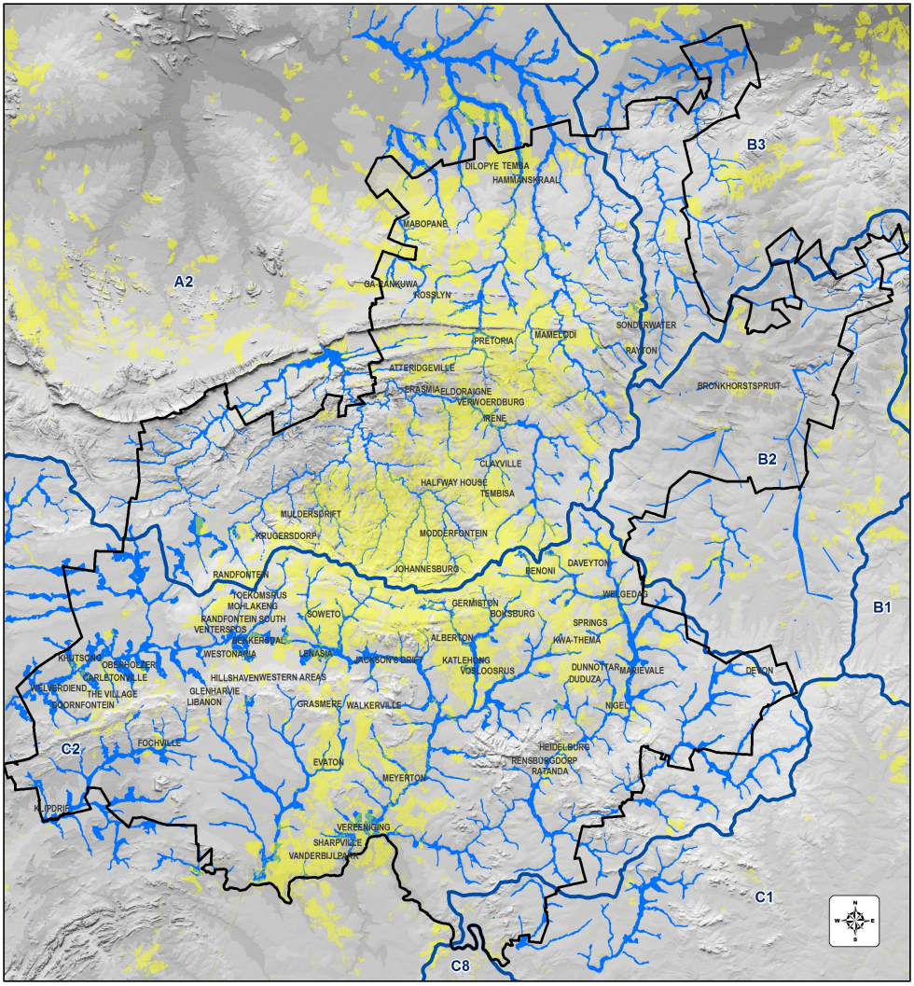

DATA PROCESSING
Inundation from PCSWM
Input >
PCSWMM
+
Notes:
The output of the PCSWMM analysis was used to determine GIS based flood inundation areas. This in itself was not indicative of flood risk areas and some additional analyses were required. This is where concepts of “vulnerability” and “hazard” as studied in the Disaster Risk Management domain, are implicated. Given my background and experience in disaster risk assessments, I thought it would be important to introduce these into this project, even on a basic level.

Slide 17
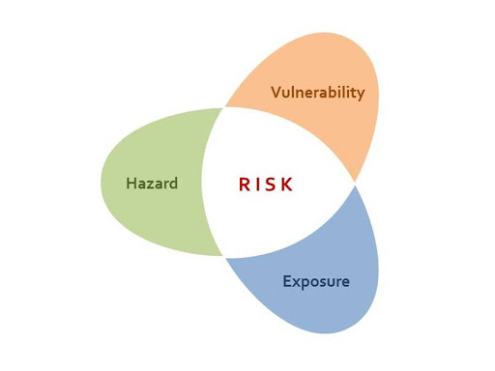
CONCEPTS OF DISASTER RISK
Energy
Sensitivity
Resilience
Notes:
Whereas the project was originally focussed on hydrological modelling, I saw the opportunity for introducing concepts of disaster risk on a basic level, adding additional value to the data analysis and outcomes of the study. The data forthcoming from the analyses presented itself as input for a basic hazard and vulnerability analysis. By integrating the data communities at risk could be identified and potential high exposure areas identified across the province.

Slide 18
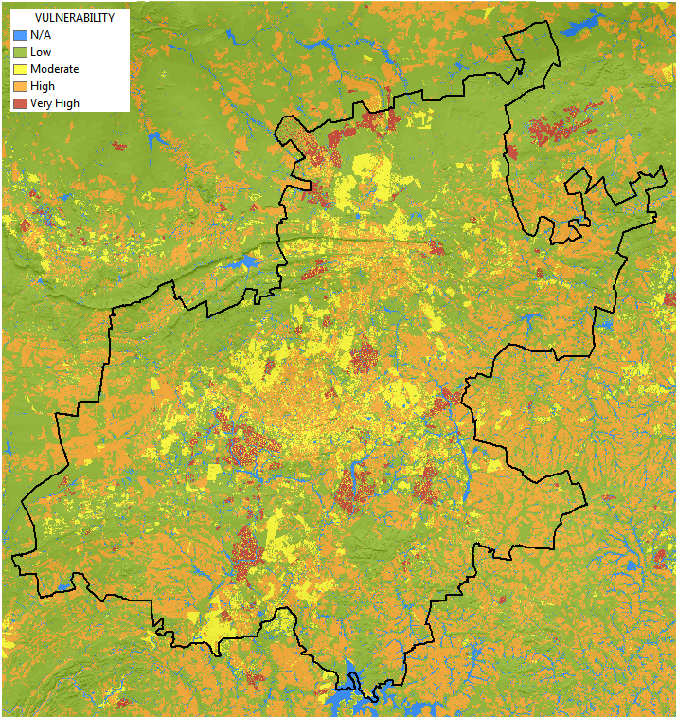
VULNERABILITY ANALYSIS
Land use based Vulnerability
Land cover -
Applying Weighted Ratings
Notes:
Being limited by budget and time constraints a basic vulnerability assessment was undertaken making use of existing land cover data. Weighted vulnerability values were assigned to different land cover classes, based on the Social Vulnerability Index (SoVI) developed by Cutter et al. (2003). This could be used to determine areas with low to high vulnerability characteristics.

Slide 19
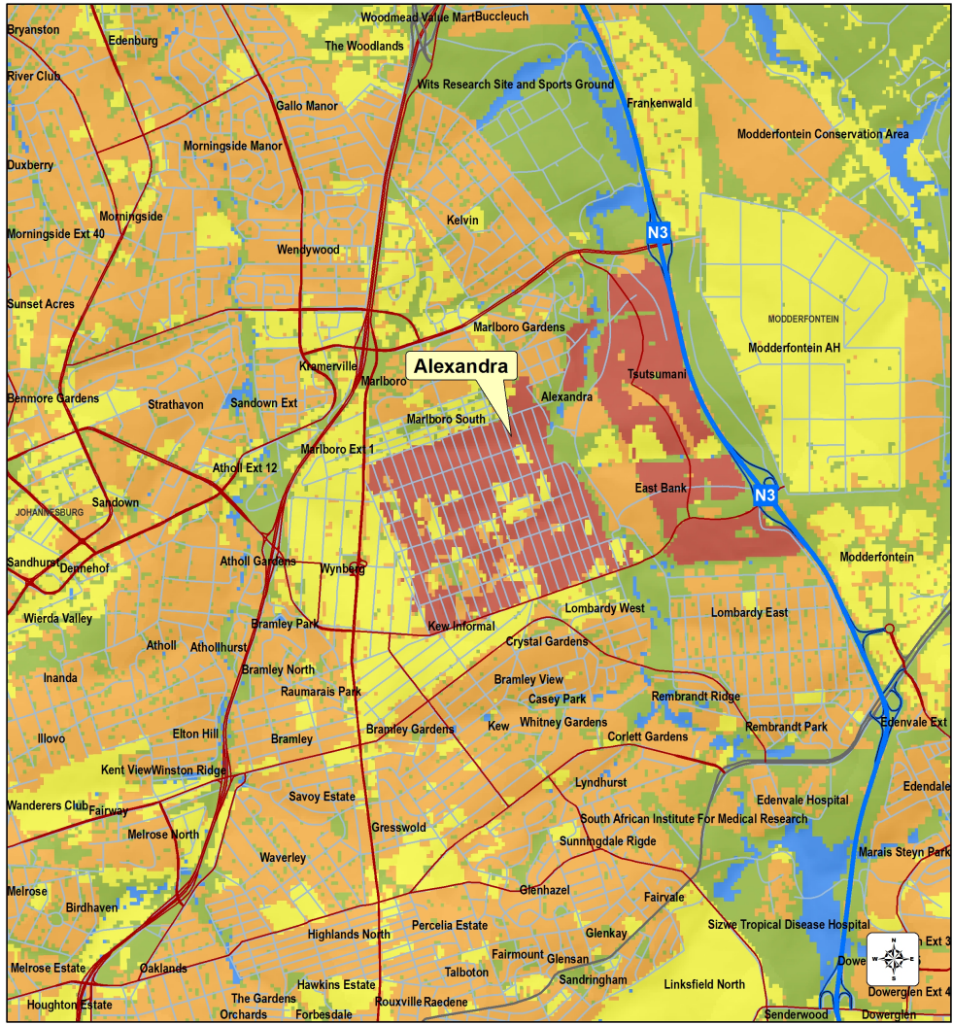
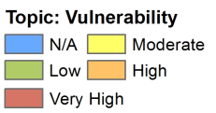
VULNERABILITY ANALYSIS
Land use based Vulnerability
Notes:
Zooming into the Alexandra area the distinct vulnerability levels from low to very high are noted.

Slide 20
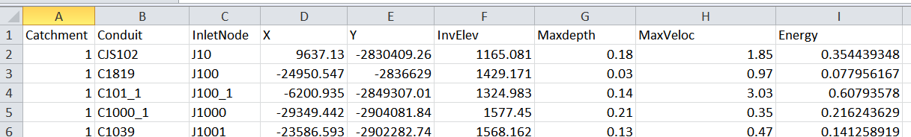
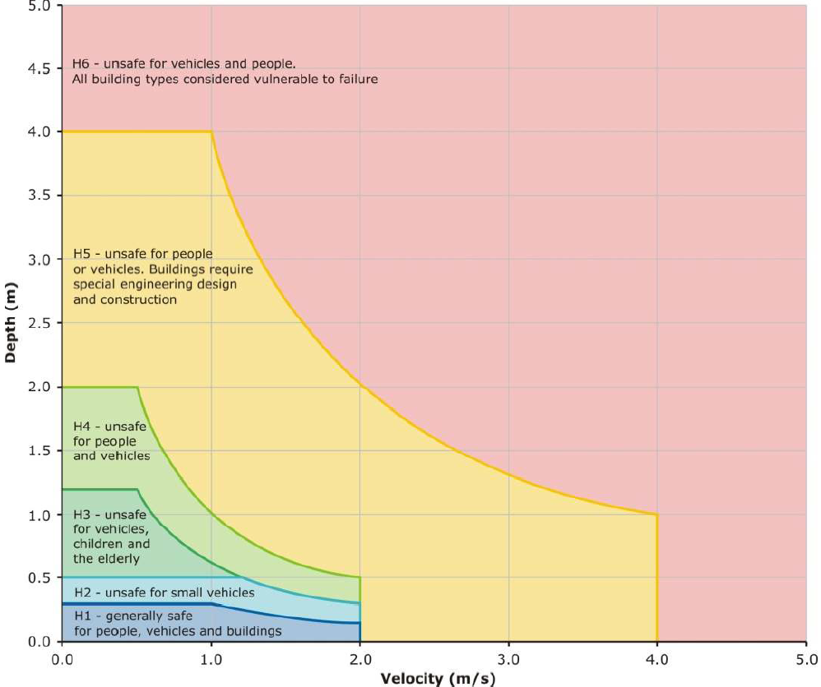
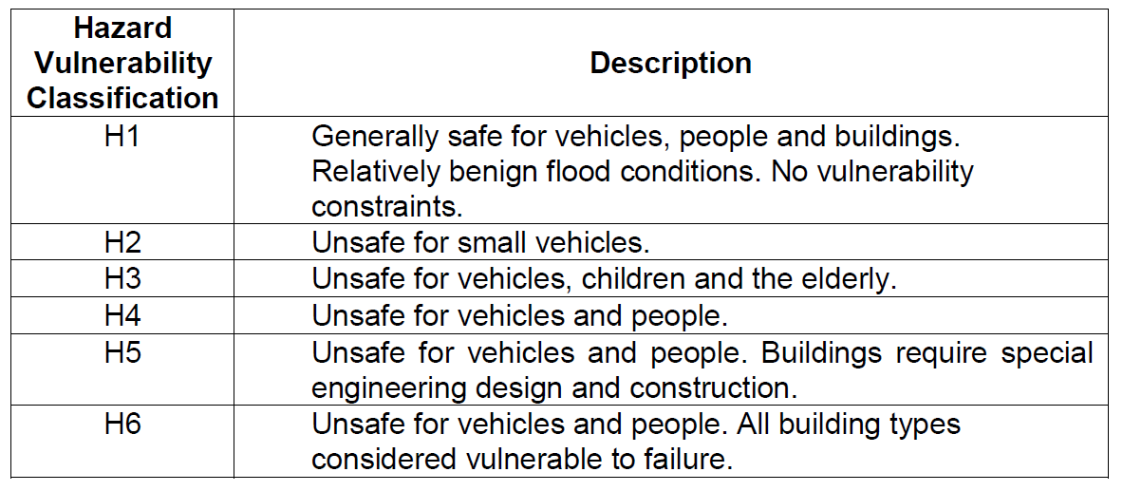
FLOOD HAZARD ANALYSIS
Flow Energy : 23 713 data points
Smith et al., 2014
Notes:
Flow energy has been calculated for more than 23 000 points along the conduits as shown earlier. The energy values were classified to arrive at a hazard classification based on the probability of damage associated with certain energy levels.

Slide 21
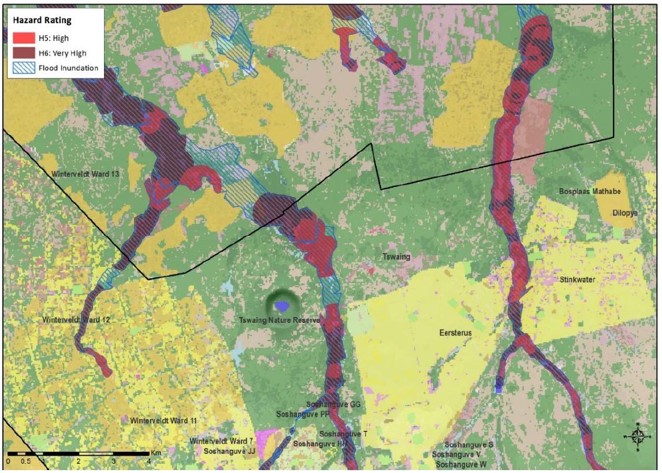
FLOOD HAZARD ANALYSIS
Hazard Classification &
Visualisation
Notes:
The outcomes of the processing of spatial data into a hazard classification can be seen on this map.

Slide 22
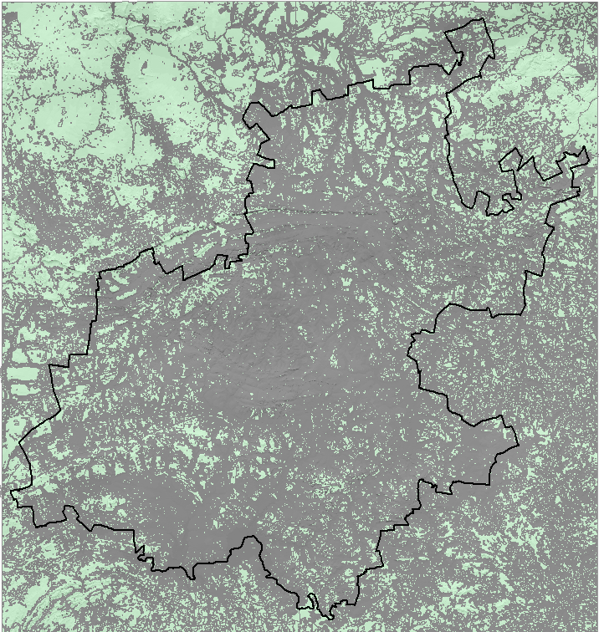
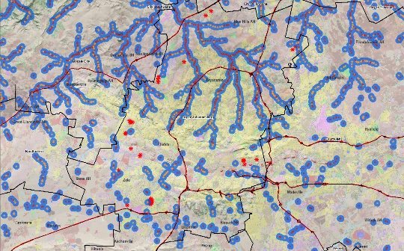
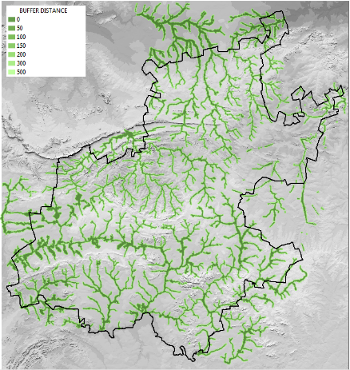
SPATIAL DATA INTEGRATION
Creating Spatial Facets (Geons)
+
+
+
Notes:
The final dataset is a ‘FloodRisk’ data product that was produced from the integration of the various input datasets as described earlier. This represents a “wall-to-wall” vector dataset consisting of polygon facets which are homogenous in terms of the underlying spatial attributes. These are made up of a complex, multidimensional geographical reality in terms of analysis components with underlying topographical, hydrological, social and physical spatial phenomena. In literature these facets are referred to as Geons (Kienberger et al., 2009) and are considered as integrated ‘wholes’. This map shows an example of the spatial data product representing a multitude of Geons.

Slide 23
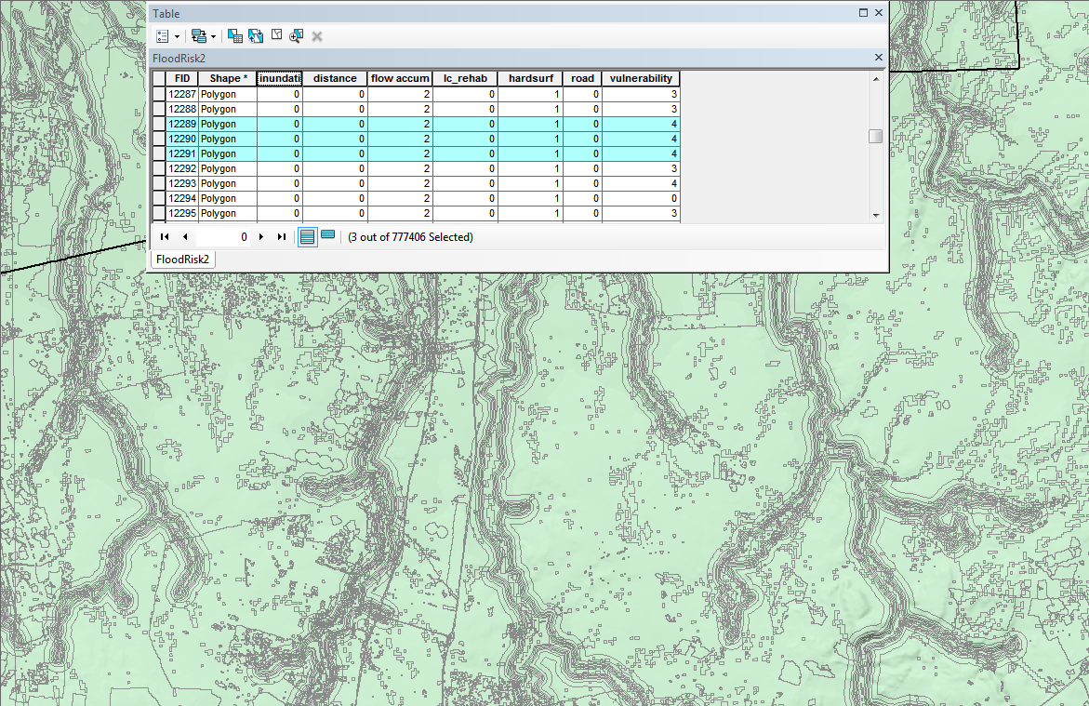
Notes:
Zooming in a bit, the nature of the data is demonstrated. Most important is the associated alpha-numeric database which contains all the attributes and values of the merged datasets. From this a multitude of queries to extract specific themes and views can be undertaken.

Slide 24
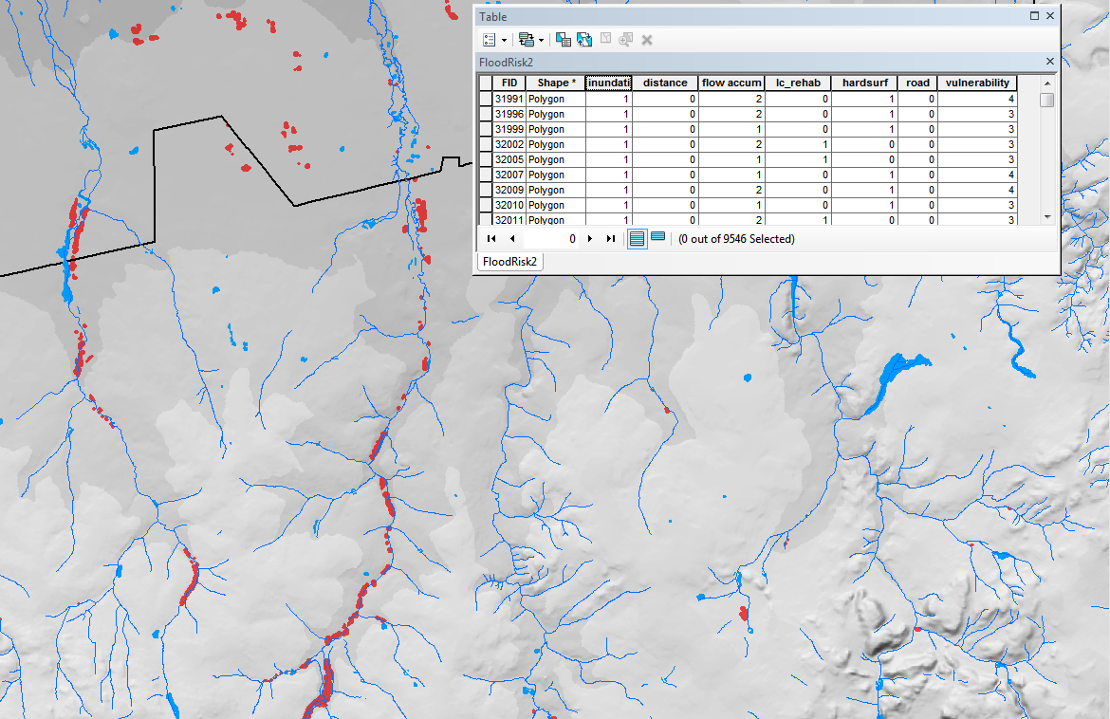
SPATIAL QUERY
SQL queries
“inundation" =1
AND “flowaccum">0
AND "distance"<51
AND “vulnerability">1
Notes:
An example of a view created from applying an SQL query extracting from the database is shown. Specified values filtered for flood inundation areas return information that is indicative of possible flood hot spot areas
Looking at the following two examples the importance of the basic vulnerability assessment to improve the outcomes of the flood risk assessment is demonstrated.

Slide 25
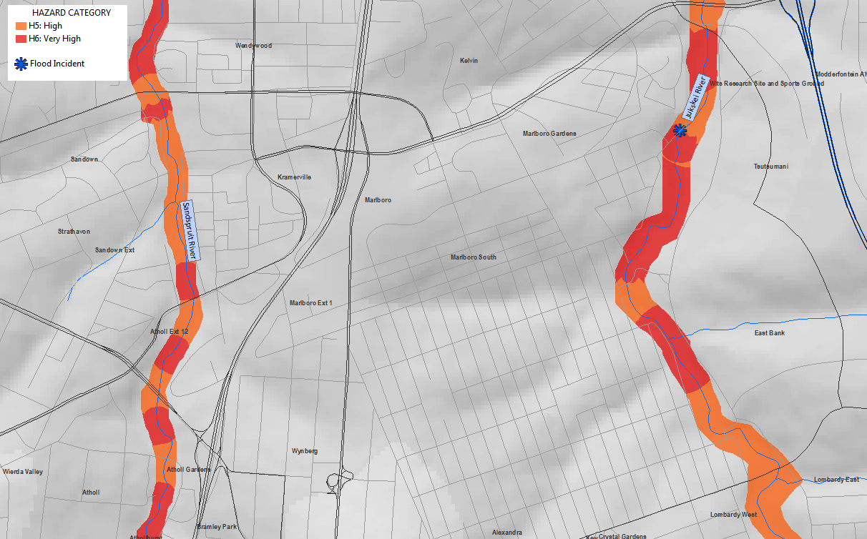
SPATIAL QUERY
Flow Energy Based Hazard
Notes:
This map shows an indicative flood hazard map for two fivers in Johannesburg, i.e. the Jukskei running through Alexandra and the Sandspruit through Sandton. Both show more or less the same hazard profile from a flow energy perspective. In accordance with the original scope of work for the study, this would have been sufficient.

Slide 26
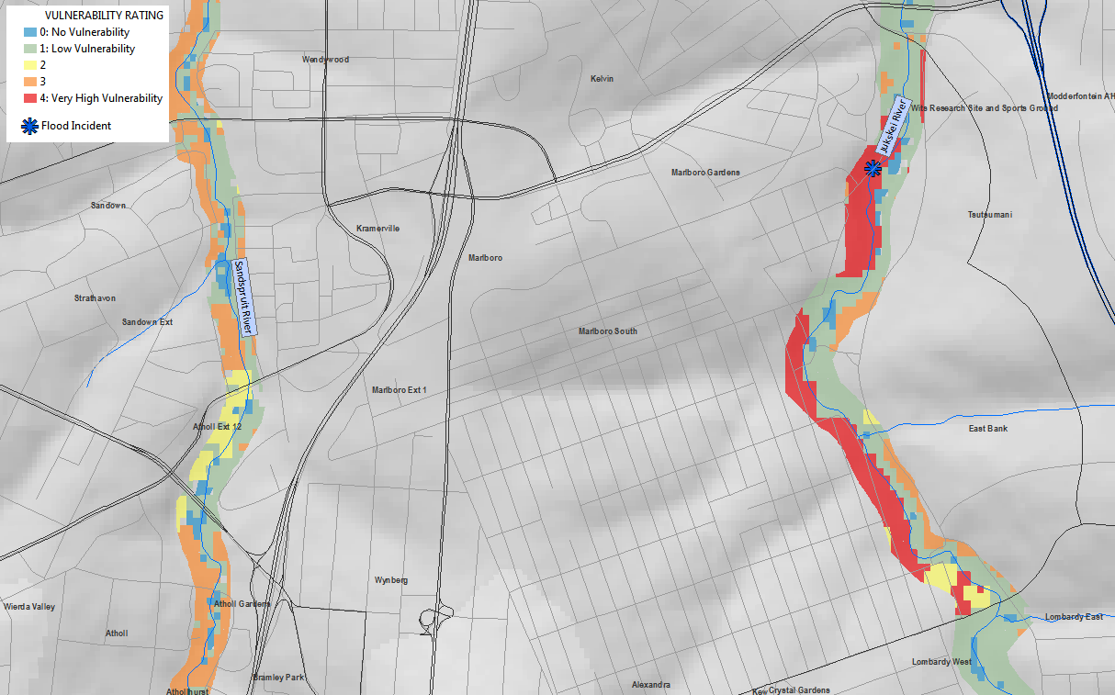
SPATIAL QUERY
Land Use Based Vulnerability
Notes:
Introducing the vulnerability dataset a distinct difference between the Sandspruit and Jukskei river is noted. The results of integrating the vulnerability data clearly show a higher flood risk in the Alexandra area. This correlates with a flooding event that was recorded earlier in Alexandra.

Slide 27
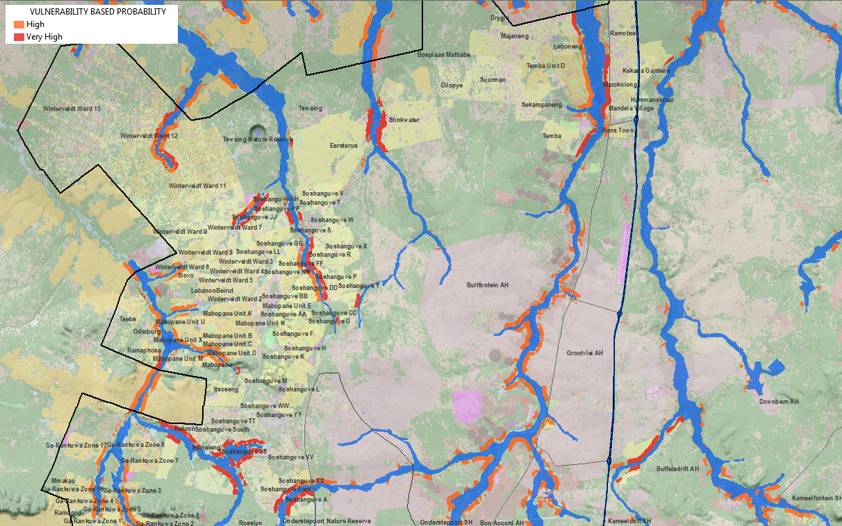
SPATIAL QUERY – SETTLEMENTS AT RISK
Spatial SQL queries
Extracting Human Settlements and Agric Production Areas at Risk
Notes:
This example shows correlation with existing flood lines of the north Gauteng area where flooding is a frequent event.

Slide 28
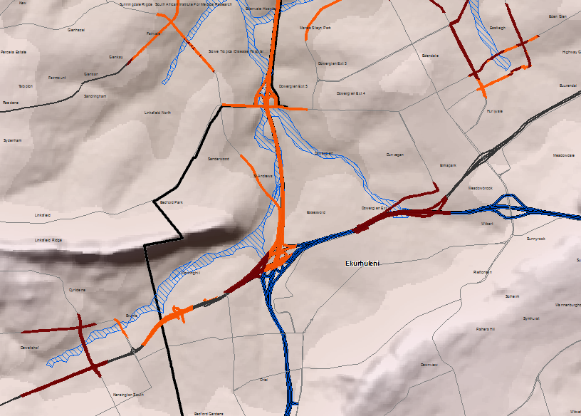
SPATIAL QUERY – CRITICAL INFRASTRUCTURE AT RISK
GIS Based Approaches
CAD Based Approaches
Spatial SQL queries
Extracting Road Surfaces at Risk
Geodatabase
Relationships
2D/3D Model
Objects
Notes:
In this example the intersection of two major transport axes in Gauteng, i.e. the N3 and N12 freeways is noted: The importance to capture and include road surfaces into the integrated database is highlighted, i.e. included in the risk profile database, and not overlaid as a non-intelligent road lines layer.
Furthermore, the principle of a Geo-centered paradigm is highlighted. Whereas the intention of the GIS component was originally focussed on map production, the analysis power of GIS was demonstrated as it became the hub for all information, not only for original hydrological modelling, but also the basis for a flood risk assessment that was undertaken as a value add to the project

Slide 29
Thank you!
☺

