Slide 1
SAGC PRESENTATION 15/05/2025
GIS Career day
road to professional registration
Mr. Luyanda Gqiba Manager: Profession Support

Slide 2
CONTENTS
Introduction
Establishment of SAGC
Geomatics Branches
Geomatics Categories
Registration of process
Required NQF Level per category
Registration Statistics
Contact information for support

Slide 3
Introduction
REGULATORY
The South African Geomatics Council (SAGC), is a fundamental regulatory body that governs and promotes the geomatics profession in South Africa.
STANDARDS
SAGC plays a vital role in advancing the geomatics industry and ensuring the highest standards of professionalism and competence among practitioners
VISION
A transformed and accountable Geomatics profession in the interests of the public
MISSION
To regulate the Geomatics profession in South Africa by setting, instilling, and enforcing ethical and professional standards
VALUES
Fairness, Respect
Integrity
Professionalism
Accountability
Competency

Slide 4
Introduction
SAGC Council Chairperson
Nape Mojapelo – 2018-2020 & 2021 to current
SAGC Registrar
Morena Letsosa – April 2024

Slide 5
INTRODUCTION-
HISTORIC JOURNEY
1910
These four territories retained their individual legislation until the Land Survey Act 9 of 1927
1950
The year 1950 saw the enactment of the Land Surveyor’s Registration Act No. 14 0f 1950. The planning and discussion leading up to this registration started sixteen years prior to the enactment, in 1934
1984
The Land Surveyor’s Registration Act No. 14 of 1950 was later superseded by the Professional Land Surveyors Act No. 40 of 1984
1927
The Land Survey Act 9 of 1927 put South African surveying in the position it is in today
1971 - 1986
The Sectional Titles Act made it possible for plots and portions of buildings to be individually owned
2013
Geomatics Professions Act 19 of 2013 was enacted as an encompassing and transformational legislation
1845
Natal becomes an independent district. The Transvaal and Orange Free State follow suit between 1866 - 1876
1806
Stricter Policies for Land Registration procedure
1657
First Land Surveyor came to the Cape

Slide 6
ESTABLISHMENT OF SAGC
The SAGC is establish as juristic in terms of Section 3 of the Geomatics Profession Act, Act No 19 of 2013.
Geomatics Basic Principles
Determination & recording of shapes, size, position, contour and setting out of natural and man-made features on the earth on the land surface, or Sea or under ground
Spatial positioning & monitoring of objects, physical features, structures and engineering works
Planning & determination of boundaries of land & of rights in land for registration of same in terms of applicable legislation
Design, establishment & administration of geographic information systems and collection, storage, analysis, visualization and management of geospatial information
Measurement of land, mineral and marine resources

Slide 7
GEOMATICS BRANCHES OF REGISTRATION
The Council has the following registration Branches to cover Geomatics Field:
Land Surveying Branch
Engineering Surveying Branch
Mine Surveying Branch
Geo-Spatial Information Science Branch
Hydrographic Surveying Branch
Photogrammetric Surveying Branch

Slide 8
GEOMATICS REGISTRATION CATEGORIES
2. The Council has the following registration categories to assign the applicants into the appropriate Branch:
Candidate geomatics practitioner (CGP)
Geomatics Technician (GPc)
Geomatics Technologist (GPg)
Geomatics Professional (GPr)

Slide 9
REGISTRATION PROCESS
Each Category needs to follow this process towards registration process under the Branch of Choice:
Candidate Geomatics Practitioner (CGP)
Candidate Geomatics Practitioner is a person who has obtained a Qualification from an accredited Tertiary Institution at the Correct NQF Level and is desiring to register to commence training towards registration in one of the categories under one of the branches.
Once the candidate is registered to serve articles, SAGC will supply Notes for Guidance which will stipulate the scope & period of the requisite training.
The candidate has to undertake practical training under a qualified Supervisor(Mentor) who should be registered with the South African Geomatics Council.
As soon as the scope is been covered the candidate must submit a signed Work Integrated Learning (WIL) document for Assessment.
They may be required to submit a written Essay or required or perform a Trial Test depending on the Branch & category.
All the above are submitted for Moderation and the decision of the moderation committee will be communicated to the candidate as it is the Final Decision
On approval by the Moderation, the Candidate will be allowed to write the Law Exam, only then Registration is effected.

Slide 10
REGISTRATION OF PERSONS
(Required NQF Levels for Each Category)
Geomatics Technician (GTc)
Is a person who has completed an accredited programme in Geomatics at NQF Level 6 at an accredited Institution of higher Education.
Geomatics Technologist (GTg)
Is a person who has completed an accredited programme in Geomatics at NQF Level 7 at an approved Institution of higher Education.
Geomatics Professional (GPr)
Is a person who has completed an accredited programme in Geomatics at NQF Level 8 at an approved Institution of higher education

Slide 11
GEOMATICS BRANCH STATISTICS
as at 30/03/20205

Slide 12
REGISTERED GEOMATICS CATEGORIES
AS at 30/03/2025

Slide 13
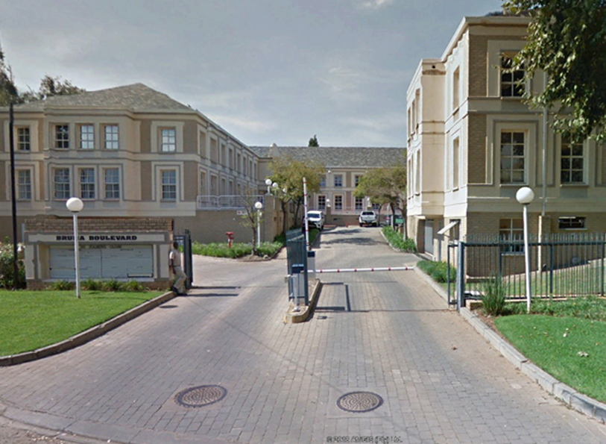
Contact information for support
Tel.: +2711 626 1040 or 1080
Office of the Registrar – registrar@sagc.org.za
The Accounting Officer
Administration of registrations – admin@sagc.org.za
Account queries – accounts@sagc.org.za
New website:
https://sagc.org.za
Physical address:
20 Zulberg Close, Bruma,
Johannesburg, 2026

